Slide 1

First-order (predicate) Logic

Slide 2
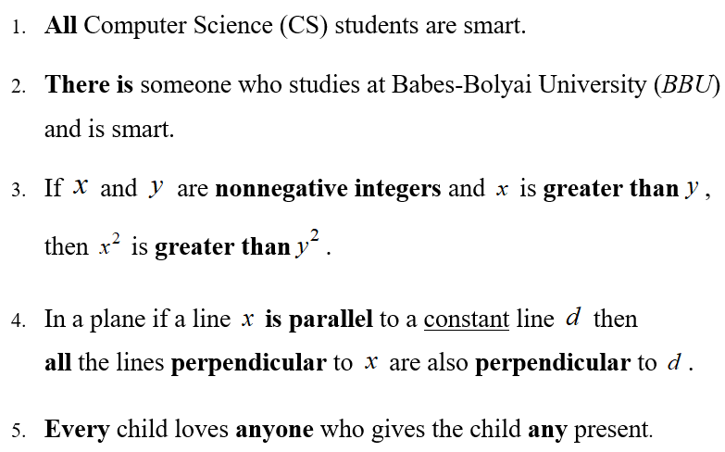
TRANSFORMATION OF NATURAL LANGUAGE SENTENCES INTO PREDICATE FORMULAS

Slide 3
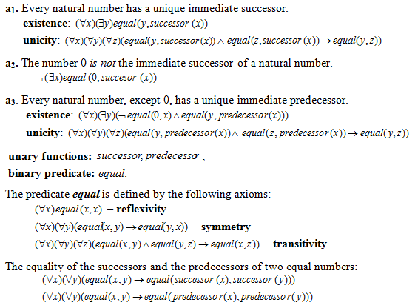
The axioms that define the natural numbers

Slide 4
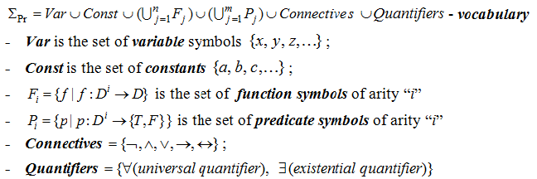
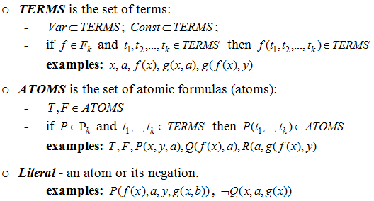
AXIOMATIC SYSTEM OF PREDICATE LOGIC

Slide 5
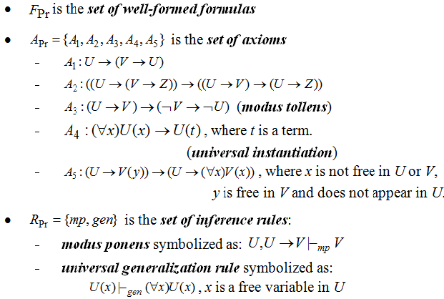
AXIOMATIC SYSTEM (CONTD.)

Slide 6
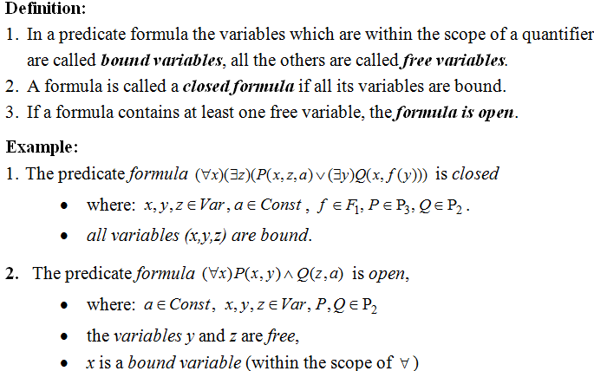
OPEN VERSUS CLOSED FORMULAS

Slide 7
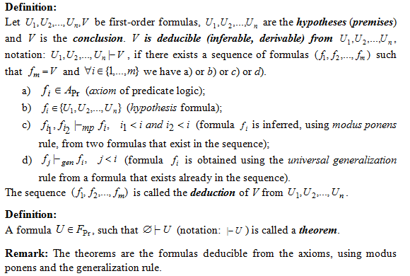
DEDUCTION IN FIRST-ORDER LOGIC

Slide 8
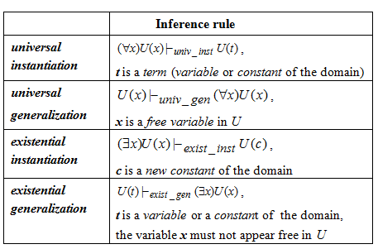
INFERENCE RULES IN FIRST-ORDER LOGIC

Slide 9
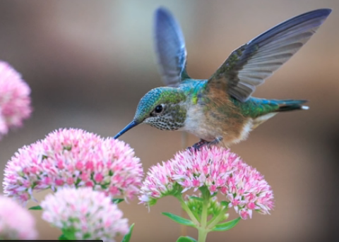
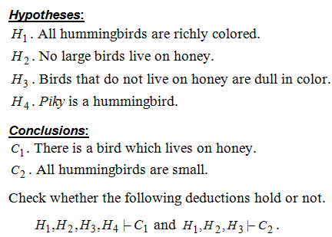
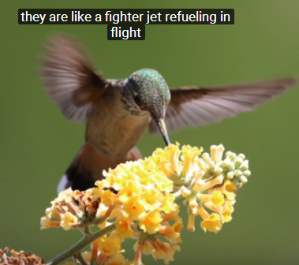
EXAMPLE 1 – MODELING REASONING

Slide 10
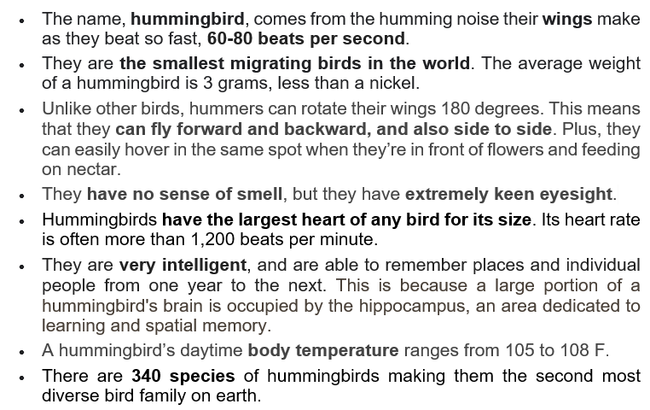
Humming birds – amazing facts
https://www.youtube.com/watch?v=FPRswRWZ23Q

Slide 11





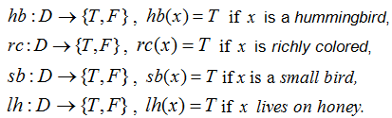

EXAMPLE 1 –MODELING REASONING (contd.)

Slide 12
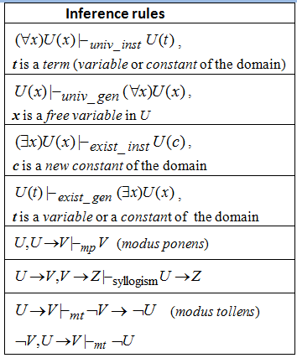
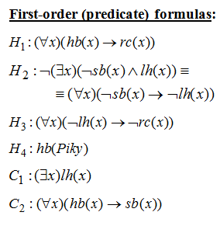
EXAMPLE 1 – BUILDING DEDUCTIONS (LECTURE)

Slide 13

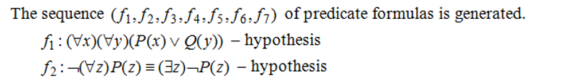
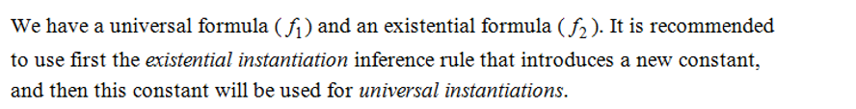

Example 2

Slide 14
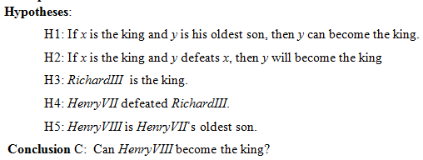
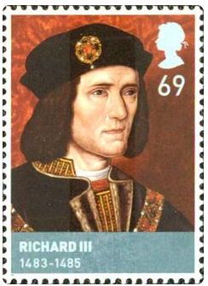
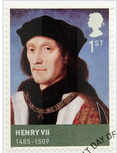
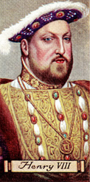
EXAMPLE 3: SUCCESSION TO THE BRITISH THRONE

Slide 15
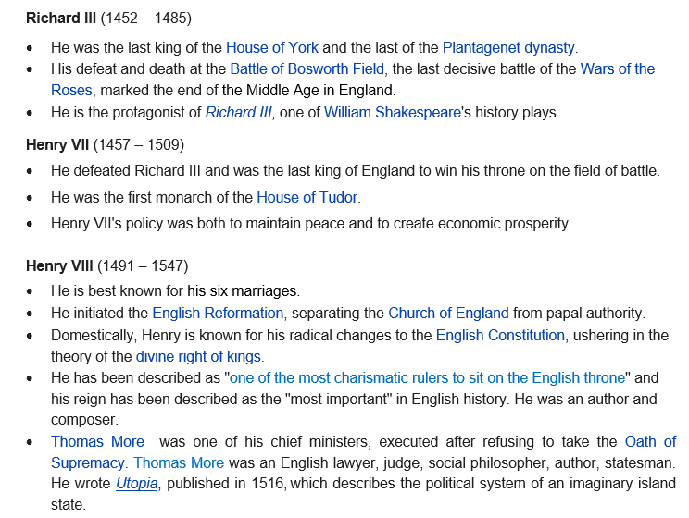
Kings of England

Slide 16
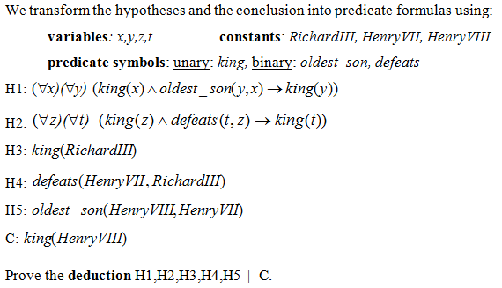
EXAMPLE 3 (HOMEWORK) SUCCESSION TO THE BRITISH THRONE

Slide 17
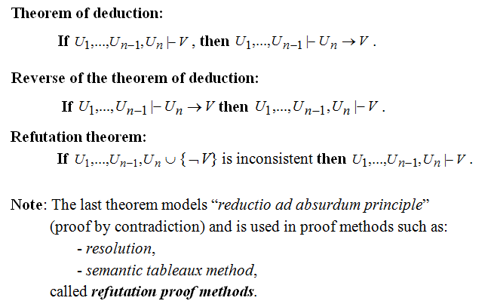
Theorems

Slide 18

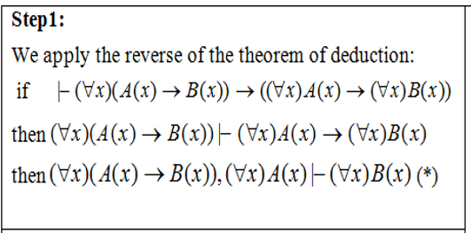
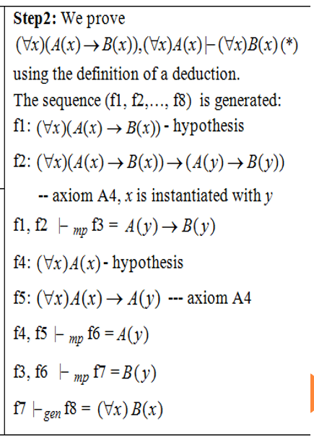
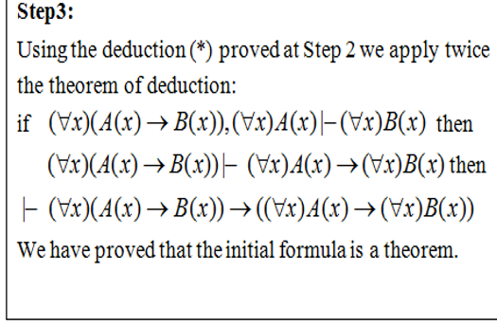

Slide 19
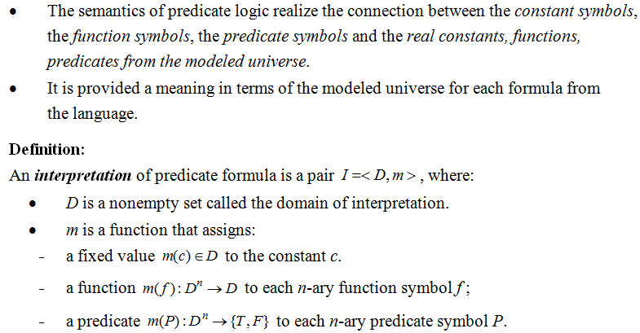
THE SEMANTICS OF FIRST-ORDER LOGIC

Slide 20
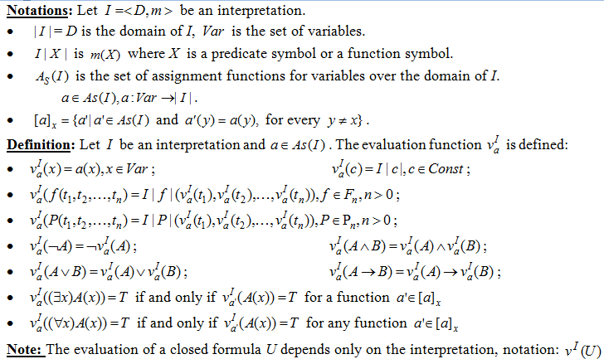

Slide 21
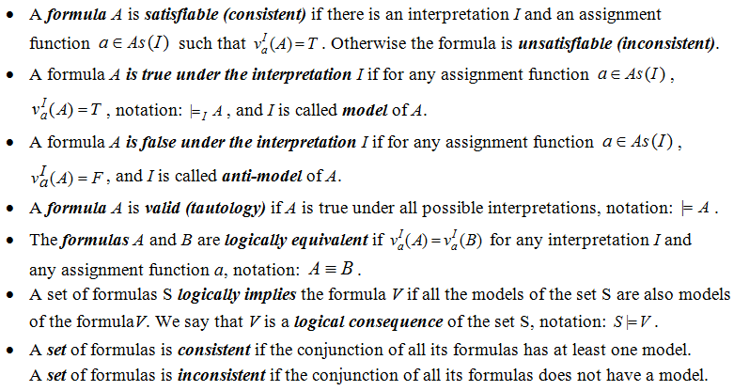
Definitions (semantic concepts)

Slide 22

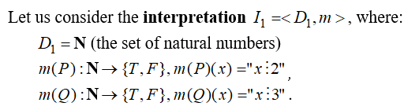

Example 5

Slide 23
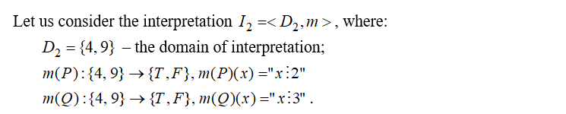


Example 5 (contd.)

Slide 24
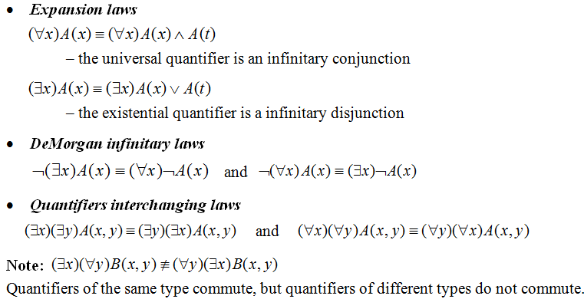
LOGICAL EQUIVALENCES IN PREDICATE LOGIC

Slide 25
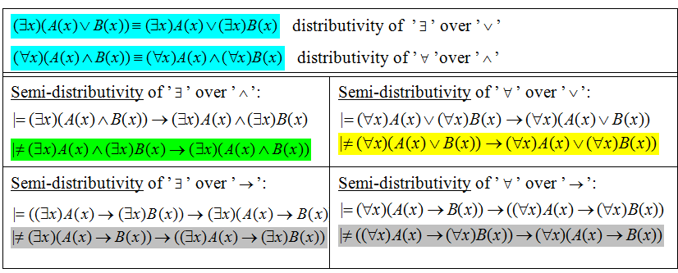
Distributive laws

Slide 26
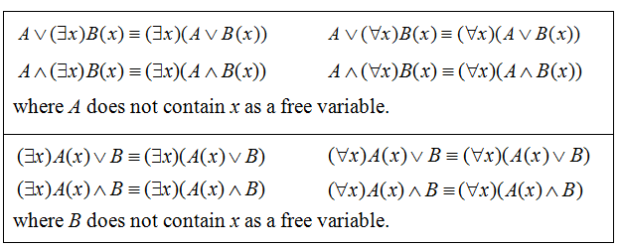
EXTRACTION OF QUANTIFIERS IN FRONT OF THE FORMULA

Slide 27
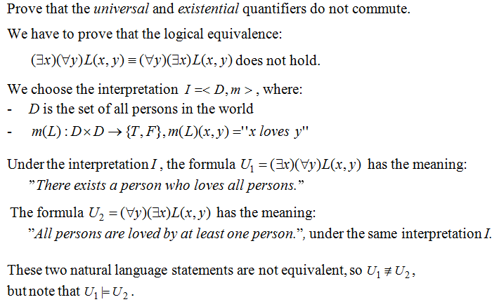
Example 6

Slide 28
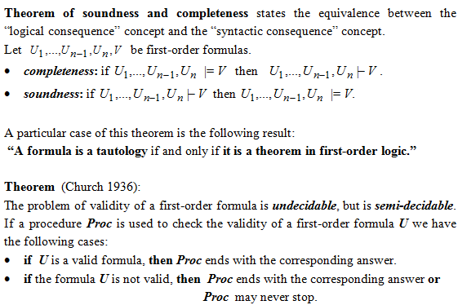
PROPERTIES OF FIRST-ORDER LOGIC: SOUNDNESS, COMPLETENESS, SEMI-DECIDABILITY

